Slide 1


Lower Mainland Christmas Bureau
Notes:
I’m Susan! I’m from the Lower Mainland Christmas Bureau!
When I ask Questions, please raise your hands to answer.
Who can tell me how many days until Christmas?
How many of you have written a Christmas list for your parents this year?
How would you feel if your parents didn’t have enough money to buy you a Christmas gift? How do you think your parents would feel?
What does it mean to give?

Slide 2
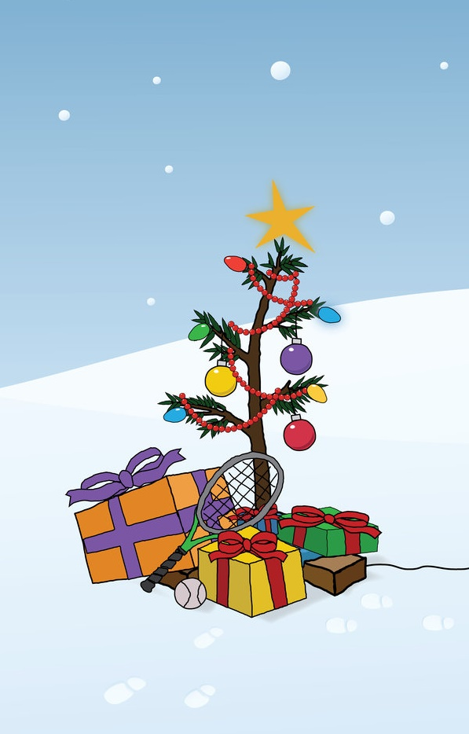
What Do We Do?
ALL KIDS GET CHRISTMAS!
SPECIAL GIFTS FROM THEIR PARENTS
YUMMY CHRISTMAS FOOD
EXCITEMENT AND FUN
Notes:
That includes:
Stocking stuffers
new and used Clothing
Books
special gifts
Gift cards for grocery stores to buy everyone’s favorite Christmas foods
How many kids go to this school? (356)
We help FIVE TIMES as many kids every Christmas as this school!

Slide 3
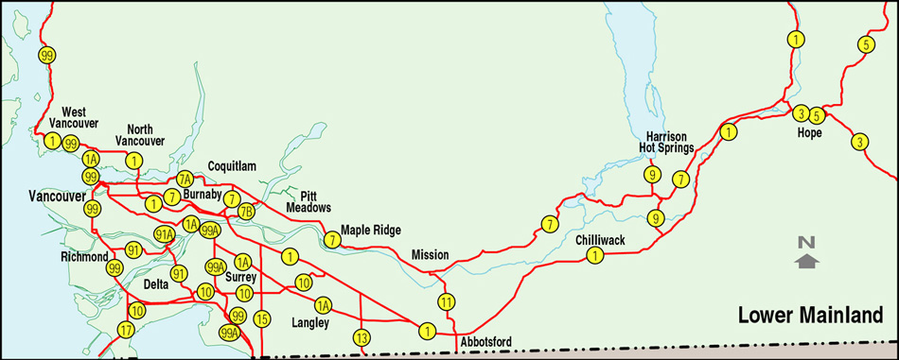
Where Do We Help?
Caulfeild School
ANYWHERE THAT NEEDS CHRISTMAS!

Slide 4
How Do We Help?
Let Parents Shop in our Special Store for gifts for their kids
Provide Gift Cards for Special Christmas Food
Give Toys to Other Groups who need them:
Daycares, other Bureaus, hospitals, special individuals, schools, and anyone who asks
Educate others & have events
Notes:
We have toys for Babies to 18 Year olds.

Slide 5
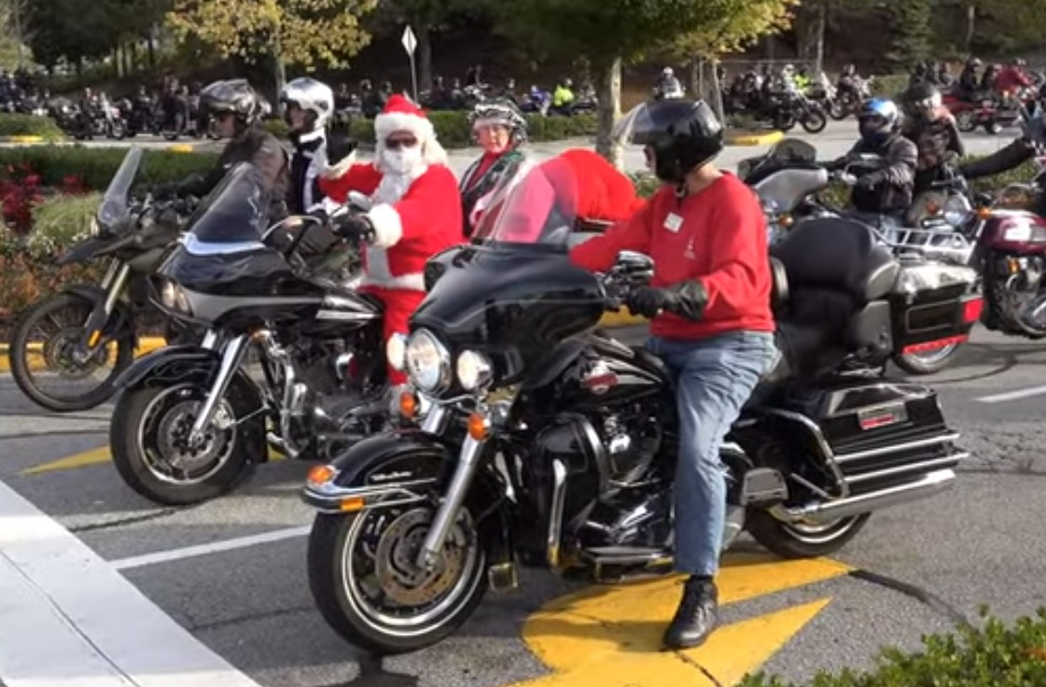
41st Annual Toy Run

Slide 6
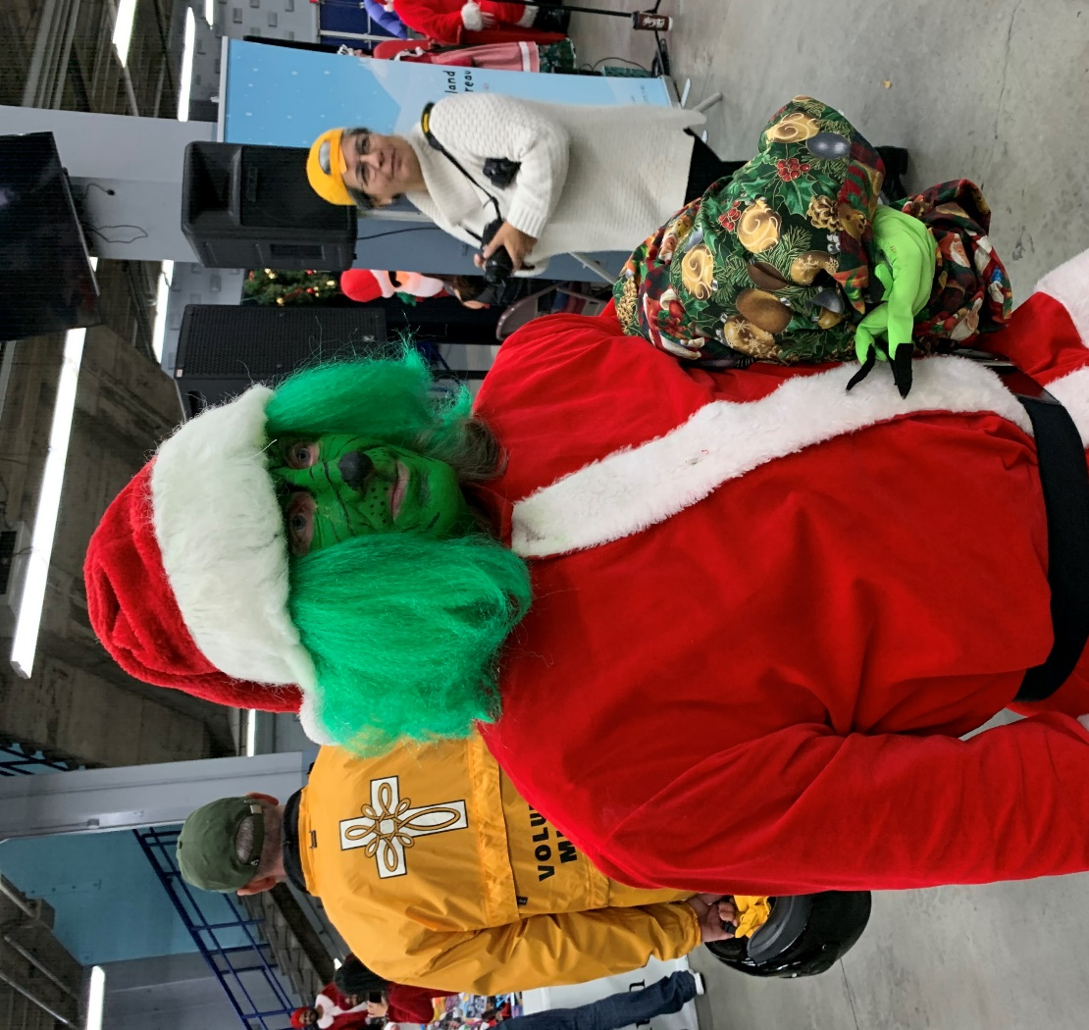
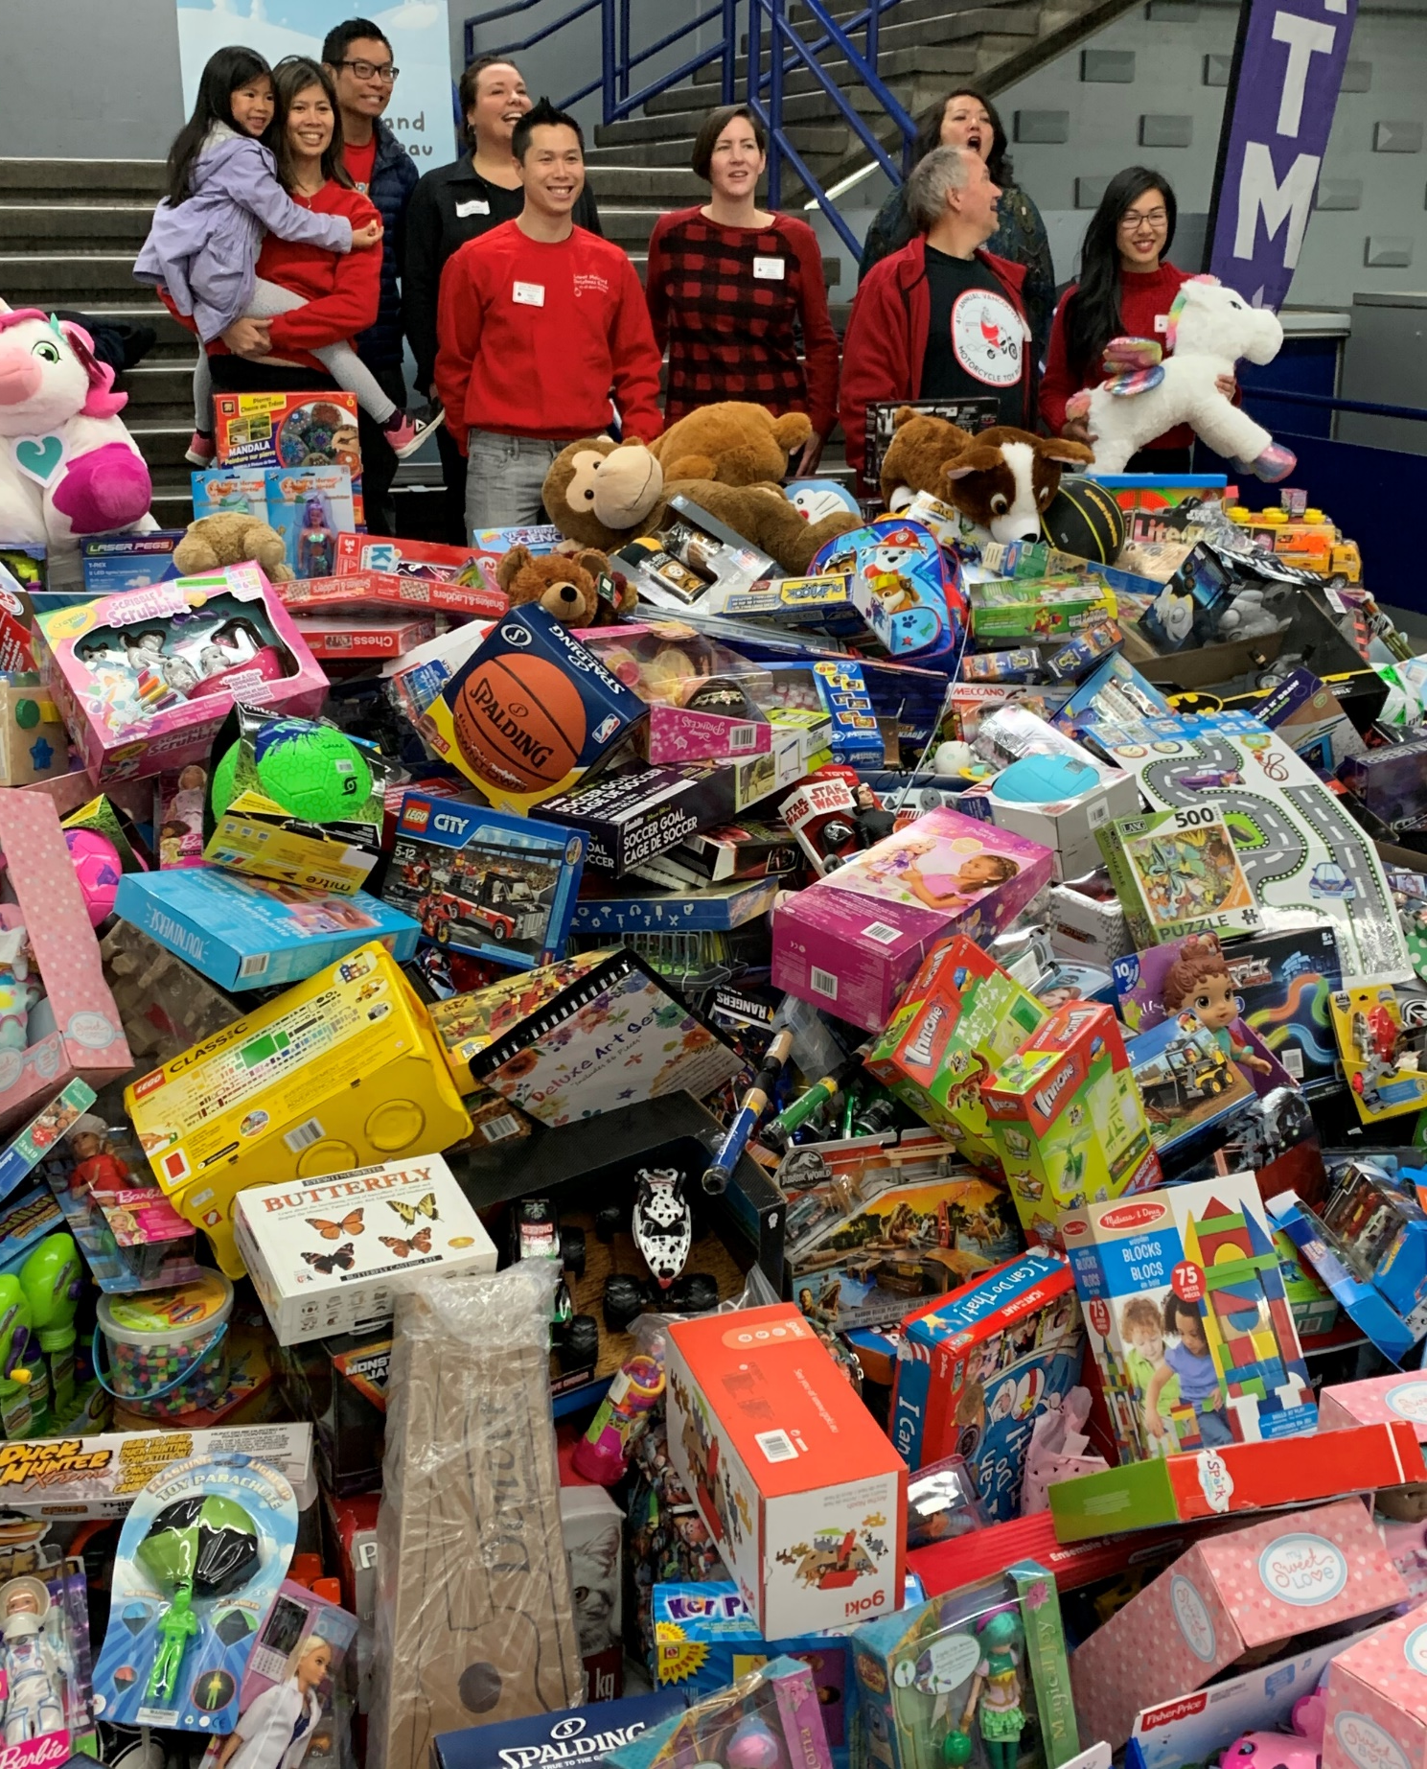
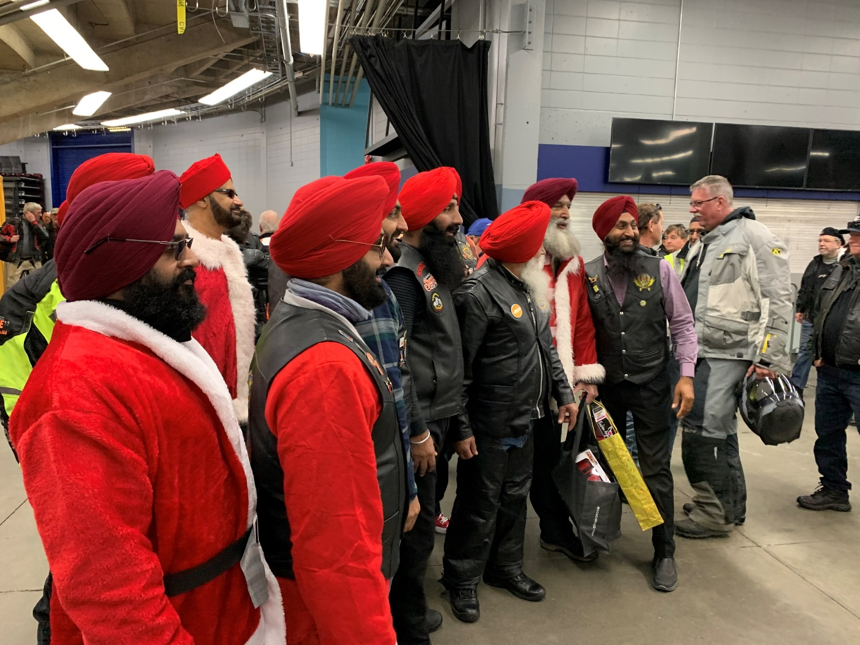

Slide 7
What Can YOU do?
Ask Caulfeild School to organize a Toy Drive and collect Money for the Christmas Bureau
Bring in a NEW toy – something that you would like to receive
Donate Money
Think about how YOU can GIVE this Christmas to other people
Notes:
Handouts if you and your parents would like to donate on-line at our website.

